Slide 1

Android Refresher

Slide 2
What are we going to cover?
Kotlin Recap
Android Studio walk through
Activities and intents
Services
Notes:
Plan
9:30 – 10:30 – kotlin
Break?
10:45 – 11:15
layouts

Slide 3
Why use Kotlin?
Less lines
Easy Code
Compatibility
Null References
A fix to Java’s flaws
Notes:
We don’t have to use kotlin!
Kotlin is a statically-typed language which is very easy to read and write. It has a much simpler and shorter code than Java’s code for the same problem. As this makes the language more human-readable, it becomes easy to debug. Kotlin’s code is much smaller and streamlines the programming process, in comparison to Java.
Kotlin programs do not need semicolons in their program. This makes the programs easy to read and understand. They also have smart casts and string templates. Such a language code increases the chances of bugs. The code being in a concise language means fewer chances of both runtime and compile time errors. Kotlin gives a simple way to use mutable and immutable declarations for different data structures.
Kotlin can easily exchange and use information from Java in a number of ways. This is one of the most powerful advantages of Kotlin. Java and Kotlin code can co-exist in the same project. Kotlin plays well with the Java programming language. Moreover, a number of Java libraries can be used in Kotlin projects, making it even more compatible.
One of the biggest advantages of Kotlin over Java is the null references.
The only possible causes of NPE’s may be:
An explicit call to throw NullPointerException();
Usage of the !! operator that is described below;
Some data inconsistency with regard to initialization, such as when:
An uninitialized this available in a constructor is passed and used somewhere (“leaking this”);
A superclass constructor calls an open member whose implementation in the derived class uses uninitialized state;
Java interoperation:
Attempts to access a member on a null reference of a platform type;
Generic types used for Java interoperation with incorrect nullability, e.g. a piece of Java code might add null into a Kotlin MutableList<String>, meaning that MutableList<String?> should be used for working with it;
Other issues caused by external Java code.
Kotlin removes the boilerplate code, greatly eliminates possible errors. It possesses features like delegations, late initializations.

Slide 4
Classes
Notes:
Using var vs val
Var – can be reassigned many times
Val – is more of a constant variable similar to final
We don’t need to specify the type as it is inferred

Slide 5
Some things we can do
VCS
Visual layout editor
Instant app runs
Fast emulator (Once it’s running ☹)
Great lint tool (365)
Easy links to Firebase and cloud services.
Java to kotlin Conversion
Starter templates
Notes:
APK analyser
Vector asset studio
Demo

Slide 6
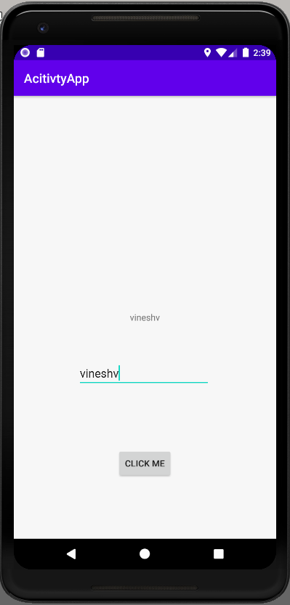
What is an activity?
A single page or “one activity”
One Activity

Slide 7
Two activities
One Activity
Two Activity
Activity 2
Activity 1

Slide 8
Three activities
One Activity
Two Activity
Three Activity
Activity 2
Activity 1
Activity 1
Activity 3
Activity 3
Activity 2

Slide 9
Activity –Life Cycle Methods
onCreate() | The first callback that is called when an activity is created.
onStart() | This callback is called when the activity is visible to the user.
onResume() | Called when the user starts interacting with the app.
onPause() | The paused activity does not receive user input and cannot execute any code and called when the current activity is being paused and the previous activity is being resumed.
onStop() | This callback is called when the activity is no longer visible.
onDestroy() | This callback is called before the activity is destroyed by the system.
onRestart() | This callback is called when the activity restarts after stopping it.

Slide 10
So what's an Intent?
An intent is a messaging object that is used to request an action from another application component.
Main_Activity
Main_Activity
New_Activity
Enter a name:
Enter a name:
The name you entered was:
James Bond
James Bond
Submit
Submit
Go back
Notes:
Intent facilitates communication between different components
An Intent is an object that provides runtime binding between separate components, such as two activities.
The Intent represents an app’s intent to do something.
There are Two types
Explicit
Implicit

Slide 11
Explicit intent
Communicates between two activities inside the same application.
Main_Activity
New_Activity
Enter a name:
The name you entered was:
JK Growling
Submit
Go back
Notes:
We enter a name and then when we submit it we go to a new activity passing in the name we entered.
If you have more then one browser then it may ask which browser you would like to use to open the link.

Slide 12

Implicit intent
Communicates between two activities of different application.
Main_Activity
New_Activity
Gmail
Chrome
Dear JK Growling
Please click the following click
www.qa.com
Kind regards,
Chewbarka
Notes:
A link in Gmail open a new application in this case chrome and passes the URL at the same time

Slide 13

Intents are used for?
Starting an activity
Starting a service
Passing data in same application or different application.
Notes:
Three reasons for why intents are used.

Slide 14

What's a service?
An application component that can perform long-running operations in the background. Services do not provide any user interface.
Notes:
long running operations, i.e., Internet downloads,

